Slide 1
3
APPLICATIONS OF
DIFFERENTIATION

Slide 2
Optimization Problems
3.5

Slide 3
APPLICATIONS OF DIFFERENTIATION
The methods we have learned in this chapter for finding extreme values have practical applications in many areas of life.
A businessperson wants to minimize costs and maximize profits.
A traveler wants to minimize transportation time.
Fermat’s Principle in optics states that light follows the path that takes the least time.

Slide 4
Optimization Problems
In this section (and the next), we solve such problems as:
Maximizing areas, volumes, and profits
Minimizing distances, times, and costs
In solving problems such as maximizing areas, volumes, and profits and minimizing distances, times, and costs, the greatest challenge is often to convert the word problem into a mathematical optimization problem by setting up the function that is to be maximized or minimized.
We need to follow some steps.

Slide 5
Optimization Problems
Steps in solving optimization problems:
1. Understand the Problem The first step is to read the problem carefully until it is clearly understood. Ask yourself: What is the unknown? What are the given quantities? What are the given conditions?
2. Draw a Diagram In most problems it is useful to draw a diagram and identify the given and required quantities on the diagram.
3. Introduce Notation Assign a symbol to the quantity that is to be maximized or minimized (let’s call it Q for now).

Slide 6
Optimization Problems
Also select symbols (a, b, c,…, x, y) for other unknown quantities and label the diagram with these symbols. It may help to use initials as suggestive symbols—for example, A for area, h for height, t for time.
4. Express Q in terms of some of the other symbols from Step 3.
5. If Q has been expressed as a function of more than one variable in Step 4, use the given information to find relationships (in the form of equations) among these variables. Then use these equations to eliminate all but one of the variables in the expression for Q.

Slide 7
Optimization Problems
Thus Q will be expressed as a function of one variable x, say, Q = f (x). Write the domain of this function.
6. Find the absolute maximum or minimum value of f. In particular, if the domain of f is a closed interval, then the Closed Interval Method can be used.

Slide 8
Example 1
A farmer has 1200 m of fencing and wants to fence off a rectangular field that borders a straight river. He needs no fence along the river.
What are the dimensions of the field that has the largest area?
SOLUTION
In order to get a feeling for what is happening in the problem, let’s experiment with some special cases.

Slide 9
Example 1 SOLUTION
Figure 1 shows three possible ways of laying out the 1200 m of fencing.

Slide 10
Example 1 SOLUTION
We see that when we try shallow, wide fields or deep, narrow fields, we get relatively small areas.
It seems plausible that there is some intermediate configuration that produces the largest area.

Slide 11
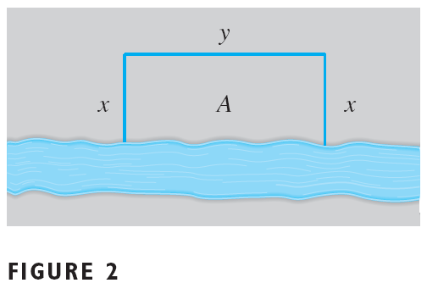
Example 1 SOLUTION
Figure 2 illustrates the general case.
We wish to maximize the area A of the rectangle.
Let x and y be the depth and width of the rectangle (in feet).
Then, we express A in terms of x and y: A = xy

Slide 12
Example 1 SOLUTION
We want to express A as a function of just one variable.
So, we eliminate y by expressing it in terms of x.
To do this, we use the given information that the total length of the fencing is 1200 m.
Thus, 2x + y = 1200

Slide 13
Example 1 SOLUTION
From that equation, we have: y = 1200 – 2x
This gives: A = x(1200 – 2x) = 1200x – 2x²
Note that x ≥ 0 and x ≤ 600 (otherwise A < 0).
So, the function that we wish to maximize is:
A(x) = 1200x – 2x² 0 ≤ x ≤ 600
The derivative is: A’(x) = 1200 – 4x
So, to find the critical numbers, we solve: 1200 – 4x = 0
This gives: x = 300

Slide 14
Example 1 SOLUTION
The maximum value of A must occur either at that critical number or at an endpoint of the interval.
A(0) = 0; A(300) = 180,000; and A(600) = 0
So, the Closed Interval Method gives the maximum value as: A(300) = 180,000

Slide 15
Example 1 SOLUTION
Alternatively, we could have observed that A’’(x) = – 4 < 0 for all x
So, A is always concave downward and the local maximum at x = 300 must be an absolute maximum.

Slide 16
Example 1 SOLUTION
Thus, the rectangular field should be:
300 m deep
600 m wide

Slide 17
Example 2
A cylindrical can is to be made to hold 1 L of oil. Find the dimensions that will minimize the cost of the metal to manufacture the can.

Slide 18
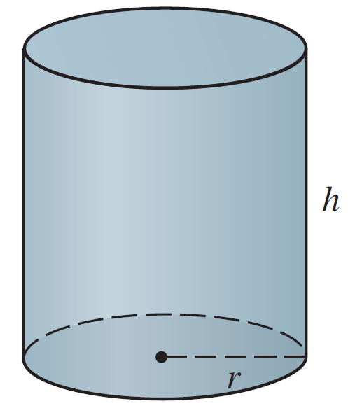
Example 2- Solution
SOLUTION:
Draw the diagram as in Figure 3, where r is the radius and h the height (both in centimeters).
Figure 3

Slide 19
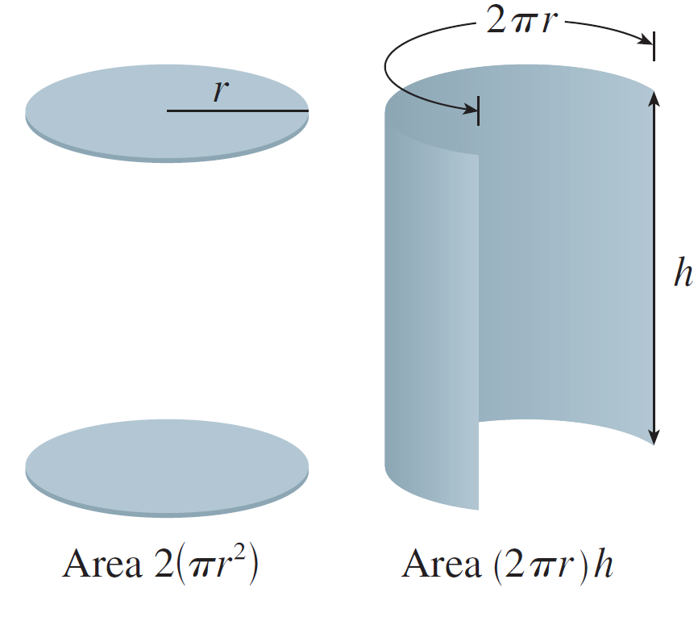

Example 2 – Solution
cont’d
In order to minimize the cost of the metal, we minimize the total surface area of the cylinder (top, bottom, and sides).
From Figure 4 we see that the sides are made from a rectangular sheet with dimensions 2π r and h.
So the surface area is
Figure 4

Slide 20


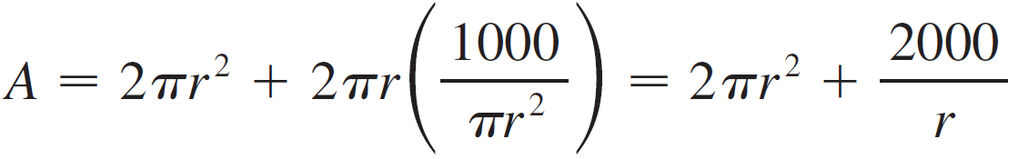
Example 2 – Solution
cont’d
To eliminate h we use the fact that the volume is given as 1 L, which we take to be 1000 cm³.
Thus
which gives
Substitution of this into the expression for A gives

Slide 21
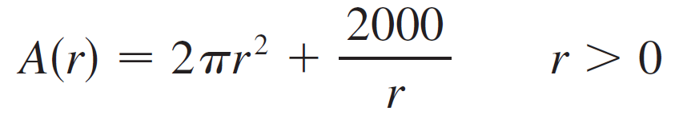
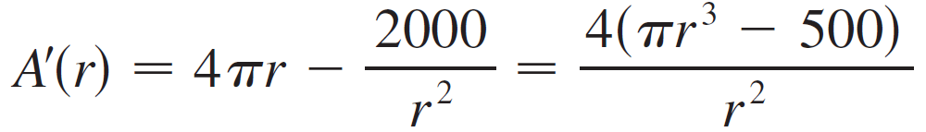

Example 2 – Solution
cont’d
Therefore the function that we want to minimize is
To find the critical numbers, we differentiate:
Then , so the only critical number is

Slide 22




Example 2 – Solution
cont’d
The domain of A is (0, ).
We can observe that and , so A is decreasing for all r to the left of the critical number and increasing for all r to the right.
Thus must give rise to an absolute minimum.

Slide 23


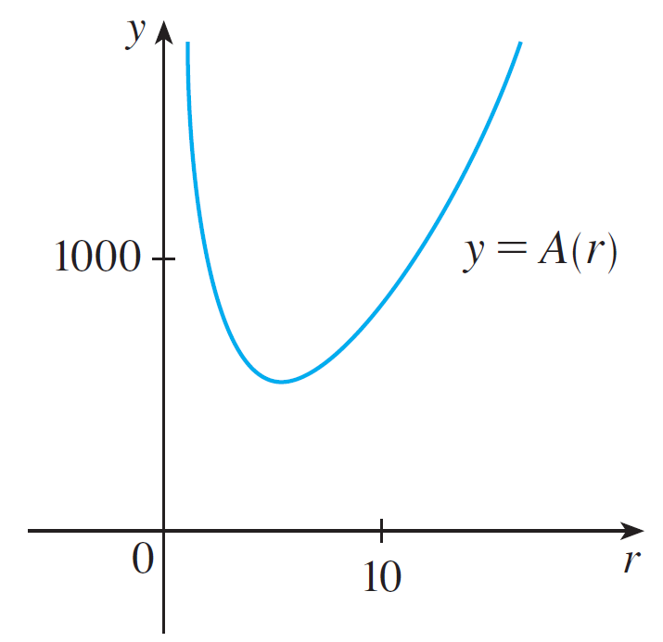
Example 2 – Solution
cont’d
Alternatively, we could argue that and so there must be a minimum value of A(r), which must occur at the critical number. See Figure 5.
Figure 5

Slide 24

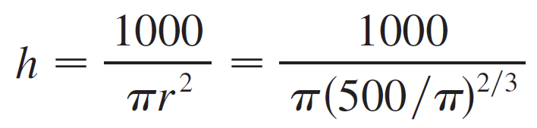
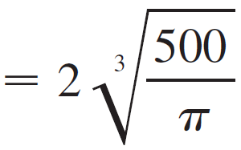


Example 2 – Solution
cont’d
The value of h corresponding to is
Thus to minimize the cost of the can, the radius should be and the height should be equal to twice the radius, namely, the diameter.

Slide 25
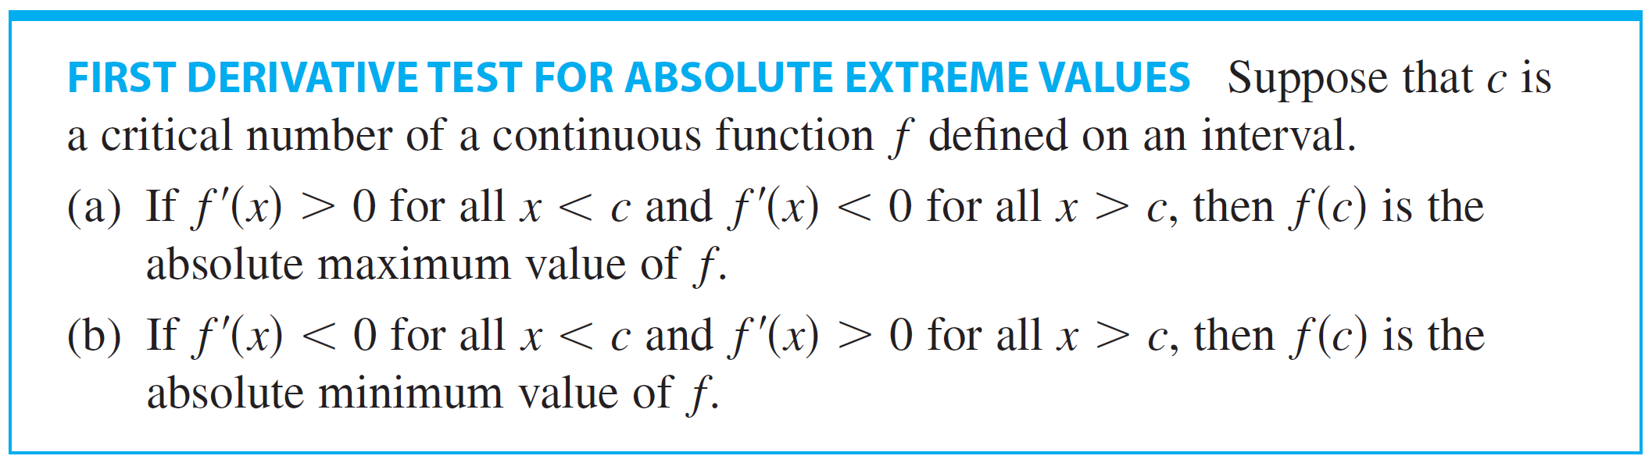
Optimization Problems
The argument used in Example 2 to justify the absolute minimum is a variant of the First Derivative Test (which applies only to local maximum or minimum values) and is stated here for future reference.

Slide 26
Optimization Problems
An alternative method for solving optimization problems is to use implicit differentiation. Let’s look at Example 2 again to illustrate the method. We work with the same equations
but instead of eliminating h, we differentiate both equations implicitly with respect to r:
The minimum occurs at a critical number, so we set
simplify, and arrive at the equations
and subtraction gives

Slide 27
Example 3
Find the point on the parabola y ² = 2x that is closest to the point (1, 4).

Slide 28
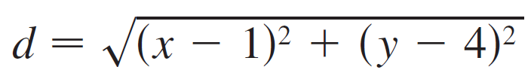
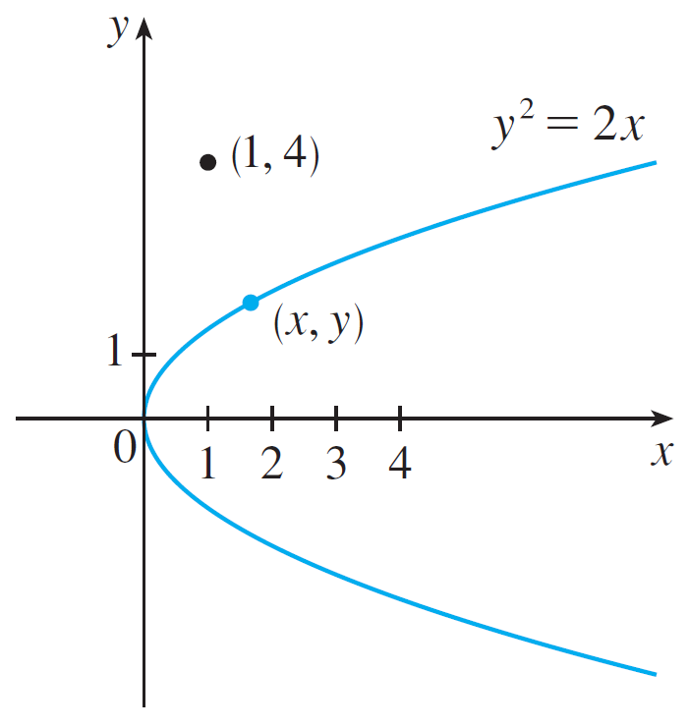
Example 3- Solution
SOLUTION: The distance between the point (1, 4) and the point (x, y) is
(See Figure 6.)
Figure 6

Slide 29
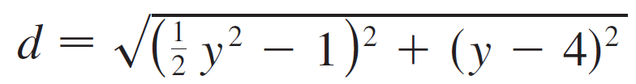

Example 3 – Solution
cont’d
But if (x, y) lies on the parabola, then x = y²/2, so the expression for d becomes
(Alternatively, we could have substituted to get d in terms of x alone.)
Instead of minimizing d, we minimize its square:
(You should convince yourself that the minimum of d occurs at the same point as the minimum of d ², but d ² is easier to work with.)

Slide 30


Example 3 – Solution
cont’d
Differentiating, we obtain
so f ′ (y) = 0 when y = 2.
Observe that f ′ (y) < 0 when y < 2 and f ′ (y) > 0 when y > 2, so by the First Derivative Test for Absolute Extreme Values, the absolute minimum occurs when y = 2. (Or we could simply say that because of the geometric nature of the problem, it’s obvious that there is a closest point but not a farthest point.)

Slide 31
Example 3 – Solution
cont’d
The corresponding value of x is x = y ²/2 = 2.
Thus the point on y ² = 2x closest to (1, 4) is (2, 2).

Slide 32
Example 4
A man launches his boat from point A on a bank of a straight river, 3 km wide, and wants to reach point B (8 km downstream on the opposite bank) as quickly as possible. (See Figure 7)

Slide 33
Example 4
He could proceed in any of three ways:
Row his boat directly across the river to point C and then run to B
Row directly to B
Row to some point D between C and B and then run to B

Slide 34
Example 4
If he can row 6 km/h and run 8 km/h, where should he land to reach B as soon as possible?
We assume that the speed of the water is negligible compared with the speed at which he rows.

Slide 35
Example 4 SOLUTION
If we let x be the distance from C to D, then:
The running distance is: |DB| = 8 – x
The Pythagorean Theorem gives the rowing distance as: |AD| =
We use the equation

Slide 36
Example 4 SOLUTION
Then, the rowing time is:
The running time is: (8 – x)/8
So, the total time T as a function of x is:

Slide 37
Example 4 SOLUTION
The domain of this function T is [0, 8].
Notice that if x = 0, he rows to C, and if x = 8, he rows directly to B.
The derivative of T is:

Slide 38
Example 4 SOLUTION
Thus, using the fact that x ≥ 0, we have:
The only critical number is:

Slide 39
Example 4 SOLUTION
To see whether the minimum occurs at this critical number or at an endpoint of the domain [0, 8], we evaluate T at all three points:

Slide 40
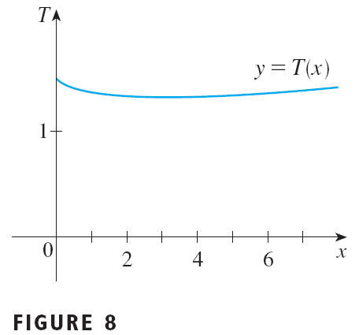
Example 4 SOLUTION
Since the smallest of these values of T occurs when x = , the absolute minimum value of T must occur there.
Figure 8 illustrates this calculation by showing the graph of T.

Slide 41
Example 4 SOLUTION
Thus, the man should land the boat at a point (≈ 3.4 km) downstream from his starting point.

Slide 42
Example 5
Find the area of the largest rectangle that can be inscribed in a semicircle of radius r.
SOLUTION 1
Let’s take the semicircle to be the upper half of the circle x² + y² = r² with center the origin.
Then, the word inscribed means that the rectangle has two vertices on the semicircle and two vertices on the x-axis as shown in Figure 9.

Slide 43
Example 5 SOLUTION 1
Let (x, y) be the vertex that lies in the first quadrant.
Then, the rectangle has sides of lengths 2x and y.
So, its area is: A = 2xy

Slide 44
Example 5 SOLUTION 1
To eliminate y, we use the fact that (x, y) lies on the circle x² + y² = r².
So,
Thus,

Slide 45
Example 5 SOLUTION 1
The domain of this function is 0 ≤ x ≤ r.
Its derivative is:
This is 0 when 2x² = r², that is x = , (since x ≥ 0).

Slide 46
Example 5 SOLUTION 1
This value of x gives a maximum value of A, since A(0) = 0 and A(r) = 0 .
Thus, the area of the largest inscribed rectangle is:

Slide 47
Example 5 SOLUTION 2
A simpler solution is possible if we think of using an angle as a variable.
Let θ be the angle shown here.
Then, the area of the rectangle is: A(θ) = (2r cosθ)(r sinθ) = r²(2 sinθ cosθ) = r² sin 2θ

Slide 48
Example 5 SOLUTION 2
We know that sin 2θ has a maximum value of 1 and it occurs when 2θ = π/2.
So, A(θ) has a maximum value of r² and it occurs when θ = π /4.
Notice that this trigonometric solution doesn’t involve differentiation.

Slide 49
Applications to Business and Economics

Slide 50
Applications to Business and Economics
Recall that if C (x ), the cost function, is the cost of producing x units of a certain product, then the marginal cost is the rate of change of C with respect to x.
In other words, the marginal cost function is the derivative, C ′(x), of the cost function.
Now let’s consider marketing. Let p(x) be the price per unit that the company can charge if it sells x units. Then p is called the demand function (or price function) and we would expect it to be a decreasing function of x.

Slide 51

Applications to Business and Economics
If x units are sold and the price per unit is p(x), then the total revenue is
and R is called the revenue function.
The derivative R ′ of the revenue function is called the marginal revenue function and is the rate of change of revenue with respect to the number of units sold.

Slide 52

Applications to Business and Economics
If x units are sold, then the total profit is
and P is called the profit function.
The marginal profit function is P ′, the derivative of the profit function.

Slide 53
Applications to Business and Economics
In Exercises 35–40, you are asked to use the marginal cost, revenue, and profit functions to minimize costs and maximize revenues and profits.

Slide 54
Example 6
A store has been selling 200 DVD burners a week at $350 each. A market survey indicates that for each $10 rebate offered to buyers, the number of units sold will increase by 20 a week. Find the demand function and the revenue function. How large a rebate should the store offer to maximize its revenue?

Slide 55



Example 6 – Solution
SOLUTION:
If x is the number of DVD burners sold per week, then the weekly increase in sales is x – 200. For each increase of 20 units sold, the price is decreased by $10.
So for each additional unit sold, the decrease in price will be and the demand function is

Slide 56


Example 6 – Solution
cont’d
The revenue function is
Since we see that R ′(x) = 0 when x = 450.
This value of x gives an absolute maximum by the First Derivative Test (or simply by observing that the graph of R is a parabola that opens downward).

Slide 57


Example 6 – Solution
cont’d
The corresponding price is
and the rebate is 350 – 225 = 125.
So to maximize revenue, the store should offer a rebate of $125.

